Slide 1
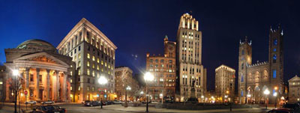
45th National Congress on Housing and Homelessness Projet Chez soi/At Home Montréal Ottawa-May 2013 /At Home

Slide 2
What is specific to Montréal

Slide 3
Old Montréal

Slide 4
Olympic Stadium

Slide 5
Habitat 67

Slide 6
Montréal Canadians

Slide 7
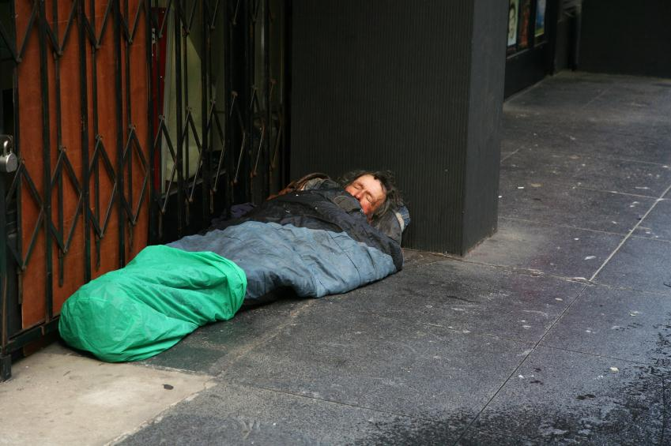
Homelessness in Montréal: some statistics
1996 – 1997: 12,666 people in situation of homelessness for at least 12 months (Fournier and al. 1998). No other study has been done since.
About 70% of them had important problems (mental health and/or dependencies) according to Fournier and al.
About 10% had severe mental disorders
In2005, the number of people in situation of homelessness was estimated at 30,000 (RAPSIM 2008)
Notes:
7

Slide 8
Last Resort Resources
8 First line organizations dealing with homelessness
Downtown rooming houses: Conversion of rooming houses into other types of dwelling, unsanitary or below standards housing units
It went from 30,000 in 1987 to less than 3,000 in 2007. The vast majority are located in downtown areas. No new census done since.
Cost of a room $ 400 to $ 500 per month
Monthly income $ 594

Slide 9
To respond to the poor housing conditions in rooming houses
Since 1987, creation of community type social housings for low income people living alone.
More than 10 000 housing units
Targeted clientele: marginalised people who otherwise would not have access to the private housing market

Slide 10
Residential Resources for people with severe mental health disorders
3222 beds in intermediary resources, group homes and supervised apartments
Under the direction and management of psychiatric hospitals.

Slide 11
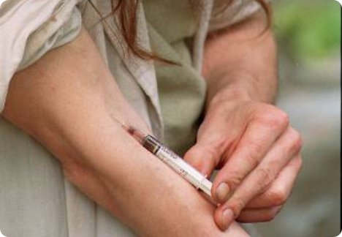
The people in situation of homelessness
Social rupture
Extreme poverty
Mental heath disorders
Dependencies (alcohol, drugs and gambling )
Social isolation and exclusion
Complex health problems
Low or high service users
Trouble with the law

Slide 12
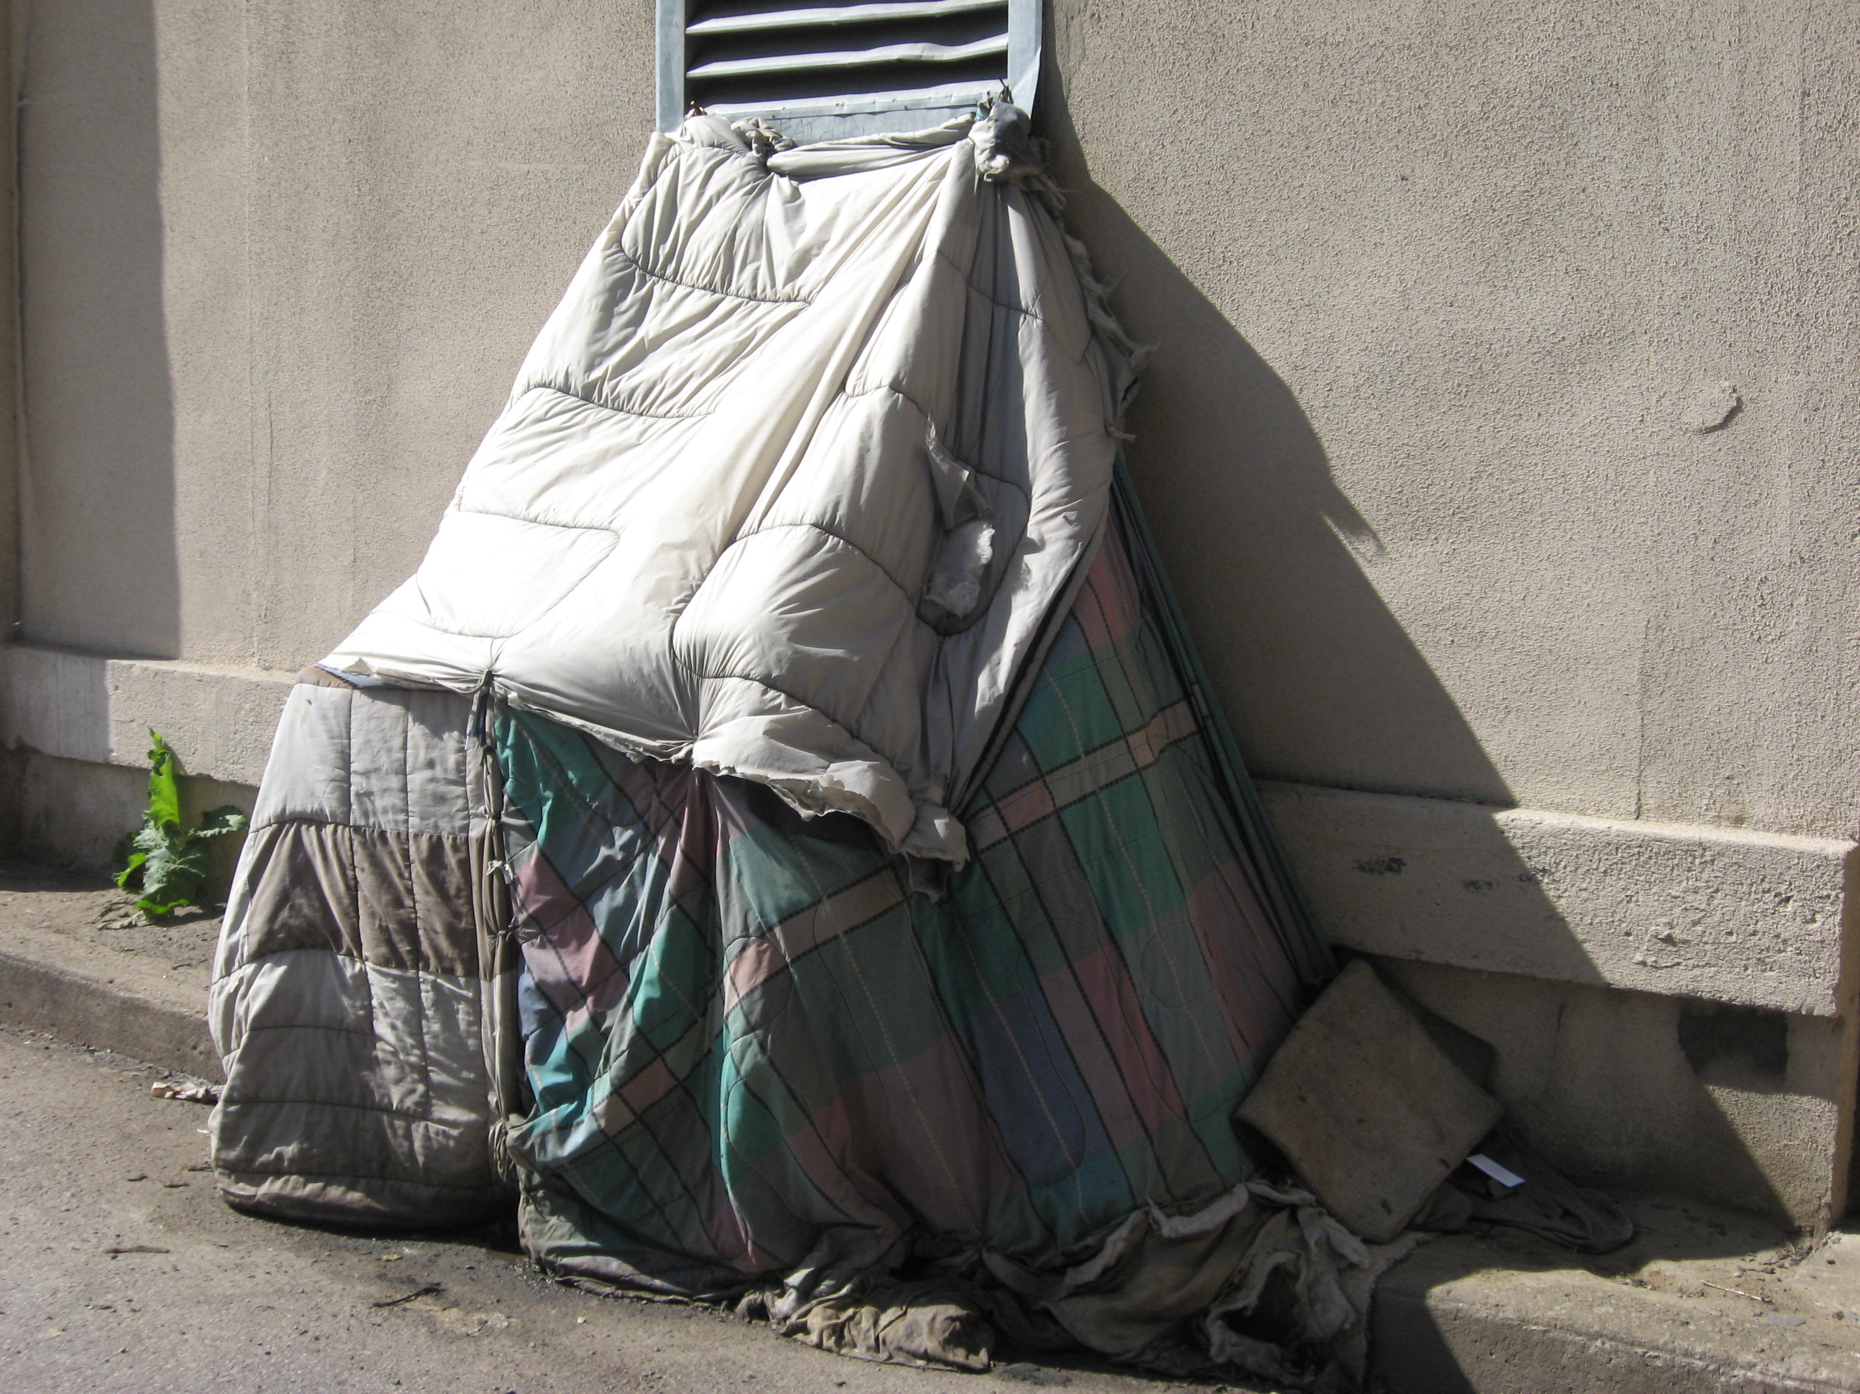

Slide 13
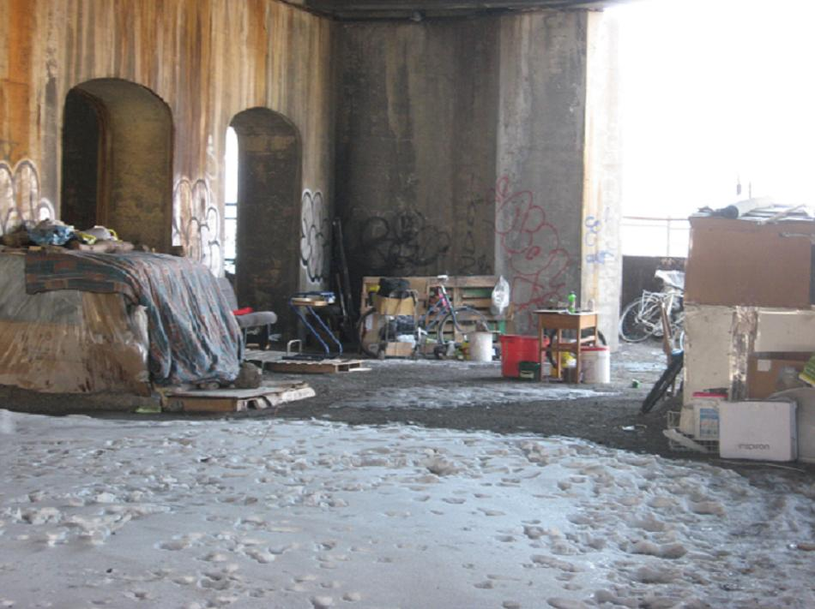

Slide 14
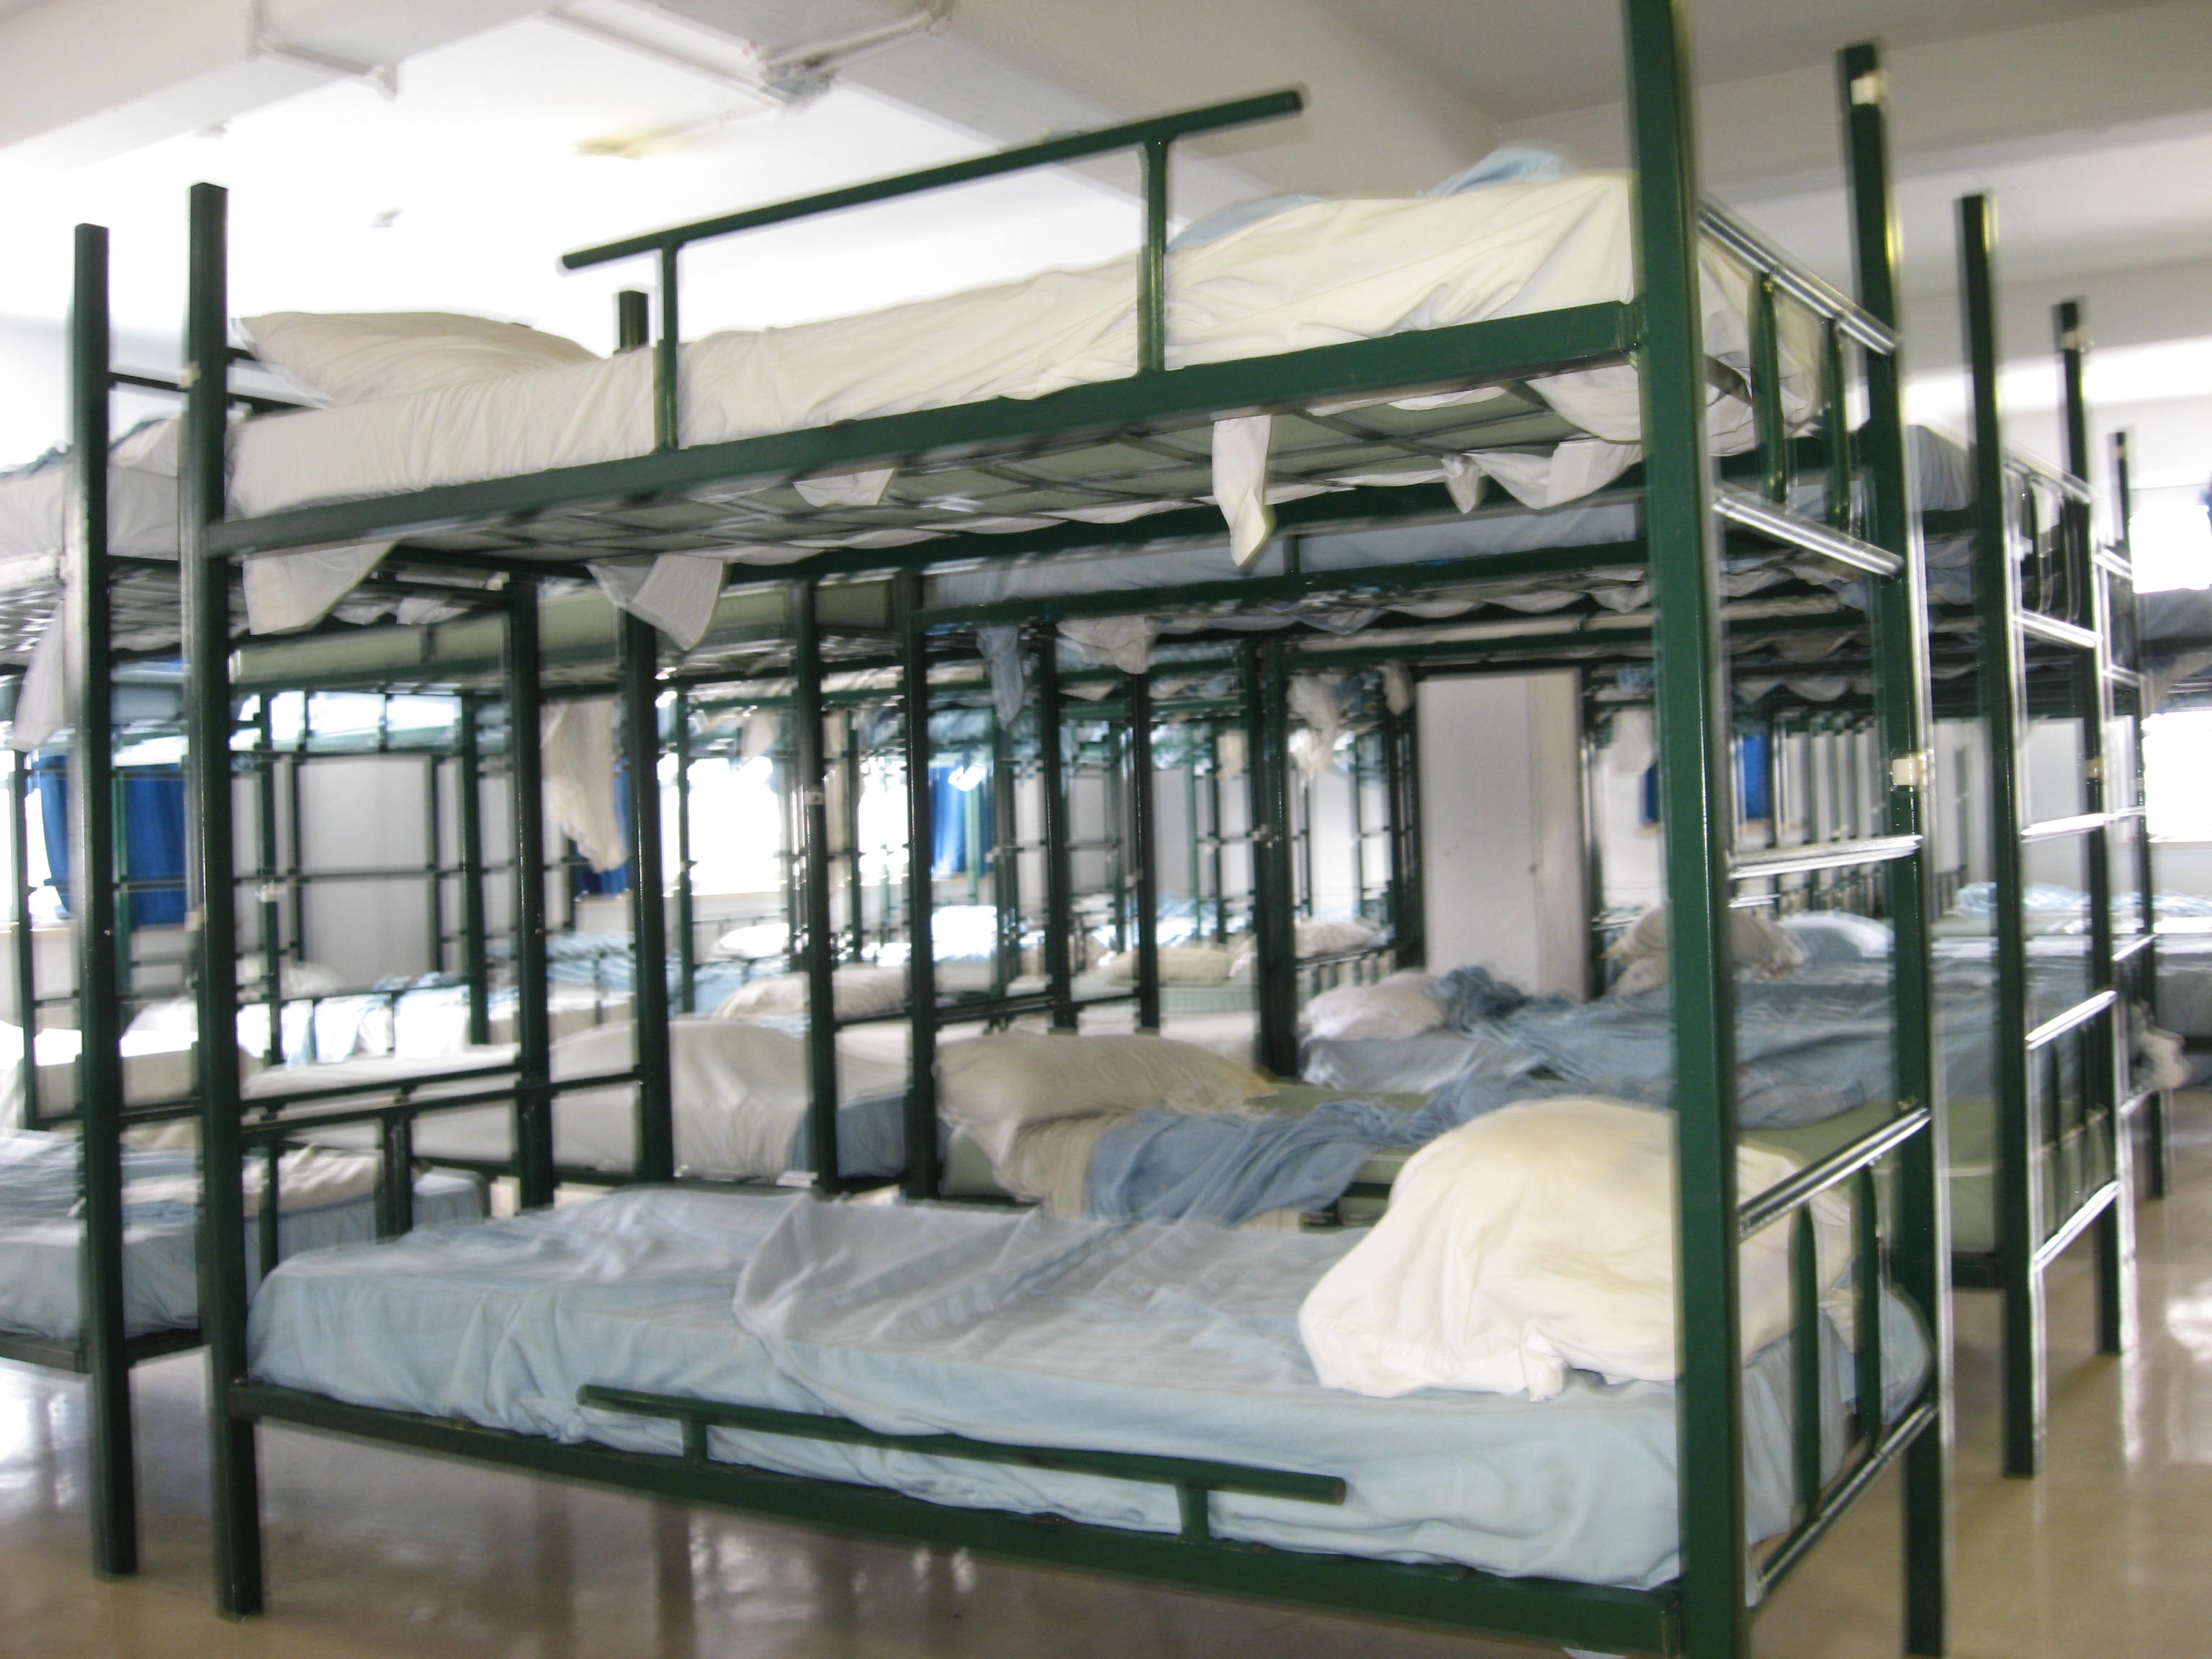

Slide 15
A unique opportunity
HOUSING FIRST
«Logement d’abord»

Slide 16
Research Team
Principal Investigator:
Eric Latimer (Douglas University Mental Health Institute Research Center, McGill University)
Principal Co-Investigators:
Marie-Josée Fleury (Douglas University Mental Health Institute Research Center)
Christopher McAll (Scientific Director, Centre de recherche de Montréal sur les inégalités sociales et les discriminations CREMIS)
Other Co-Investigators(alphabetic order):
Jean-Pierre Bonin, PhD. (Centre de recherche Fernand-Seguin, Hôpital Louis-H. Lafontaine)
Anne Crocker, PhD. (Douglas University Mental Health Institute Research Center, McGill University)
Henri Dorvil, PhD. (UQAM - École de travail social)
Roch Hurtubise, PhD. (Université de Sherbrooke, Collectif de recherche sur l'itinérance, la pauvreté et l'exclusion sociale - CRI)
Alain Lesage, M.D., M.Phil. (Centre de recherche Fernand-Seguin, Hôpital Louis-H. Lafontaine)
Greg Nielsen, PhD. (Concordia University)
Catherine Vallée, PhD. (Université Laval)
Helen-Maria Vasiliadis, PhD. (Centre de recherche Hôpital Charles-LeMoyne, Université de Sherbrooke)
Rob Whitley, PhD. (Douglas University Mental Health Institute Research Center, McGill University)

Slide 17
Questions specific to Montréal
ICM Community vs Institutional
Influence on criminality
Impact of Support for employment
Current Service Network
Impacts on families
Analysis of current practices
Impact on service user participation
Housing experience – points of view of landlords and participants
Common Questions
Housing First vs service as usual:
Effectiveness,
Cost-effectiveness
by sub-group
Life’s Trajectories, by experimental group
Implementation of projects
Implantation of programs

Slide 18
The Follow-up teams
1 ACT Team
2 ICM Team
1 Housing Team
Associated Partners :
Centre de santé des services sociaux Jeanne-Mance
Organisme communautaire Diogène
Douglas Mental Health University Institute

Slide 19
A approach consistent with current Quebec policies
The Projet Chez soi/At Home - Housing First - approach is consistent with the Quebec Government 2005-2010 Mental Health Action Plan as well as with the 2010-2013 Interdepartmental Action Plan against Homelessness;
Housing First uses ACT and ICM teams in accordance with PASM, it also fosters autonomous housing (social and private housing).
Housing First is an approach based on recovery and as such is also consistent with the philosophical orientation of PASM (person’s choice and support for integration into the community)
The development of ACT and ICM teams for homeless people with mental health problems is also consistent with the Action 24 of the Interdepartmental Action Plan against Homelessness; the use of the rent subsidies with Action 31.

Slide 20
The basis of the Housing First Model: Choices
We consider that the person is capable of taking decisions and making choices.
It is not the service providers or the professionals who decide instead of the homeless person.
Choices include the right to take risks, make mistakes and draw conclusions (ex: rehousing, maintenance of services, etc.)

Slide 21
TRADITIONAL SERVICES
HOUSING FIRST

Slide 22
Projet Chez soi/At Home is:
A research that experimented with a service model that offered autonomous housing units to 280 people, with rent supplements ($375. per month on average) and integrated clinical support (ACT or ICN). Rapid integration of housing unit with the help of a Housing team, even if the person is experiencing various difficulties (ex: drug use).
The person is not obliged to follow a program of psychiatric treatment or have reached a state of sobriety in order to be housed

Slide 23
A change of paradigm
Traditional Approaches
New Approaches
Resident
Little emphasis on social integration
Controlling environment, managed by rules
Group environment
Oriented toward shortcomings or deficits, symptoms and illness
Professional Services
Citizen – tenant–role
Social Inclusion, work, studies, etc.
Open and flexible environment
Priority to the person ‘s choice
Oriented toward strengths and potential
Importance of mutual support and peer helpers

Slide 24
When we continually make choices, we end up making the right choices and succeeding

Slide 26
Conditions for success

Slide 27
Implantation challenges and the end of the project

Slide 28
Thank you for your attention

