Slide 1
PRESENTING,
the most incredible NEW HOME VALUE
in Eastern Ontario!
YOU’LL BE AMAZED AT HOW LITTLE
HOUSEHOLD INCOME IT TAKES TO
OWN A NEW HOME IN KEMPTVILLE

Slide 2
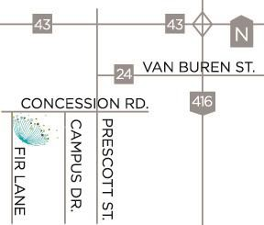
Dreams Become Reality at
Kemptville Meadows
Why rent when you can own
Only $802/mth with 5% down
Only 25 minutes to Hwy 417/Bayshore
Minutes from schools, hospitals, shopping, parks,
nature trails and more.

Slide 3
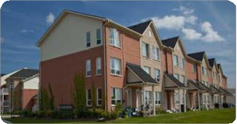
Home Ownership Alternatives
Non-Profit Corporation
Home Ownership Alternatives Non-Profit Corporation (“HOA”) is a non-profit financial corporation dedicated to making home ownership possible for modest income families.
This is accomplished through the HOA Shared Appreciation 2nd Mortgage which is administered through HOA Mortgage Services Inc. (“HOA-MSI”).

Slide 4
Benefits of an
HOA 2nd Mortgage
Supports purchasers with modest income to own a home
Provides down payment assistance
No monthly payments
Reduced carrying cost
Reduced need for mortgage default insurance

Slide 5
What is a
Shared Appreciation Mortgage?
The HOA Shared Appreciation Mortgage is a mortgage that does not bear a specific rate of interest.
Instead, the interest rate is based on the percentage increase in the value of the home from the purchase date until the mortgage is repaid.

Slide 6
No Monthly Payments
No Monthly Payments
The HOA Shared Appreciation 2nd Mortgage improves affordability as it requires no scheduled payments of principal or interest.
The HOA Shared Appreciation 2nd Mortgage must be repaid upon sale of the home or when the owner ceases to occupy the home. Home owners can also voluntarily repay the 2nd Mortgage at any time without penalty.

Slide 7
Down Payment Assistance
HOA provides down payment assistance to qualified purchasers by using its own funds and funds from Local Municipalities, the Province of Ontario, CMHC or the Federal Government.
Purchasers must also make a down payment of at least 5% of the purchase price of the home from their own resources.

Slide 8
The following criteria must be satisfied in order to be considered for
an HOA Shared Appreciation 2nd Mortgage:
Purchasers must be legal permanent residents of Canada
Purchasers must be at least 19 years old and have verifiable income
The new home must be the principal residence of the purchaser
HOA will assess each purchaser’s individual credit profile and
mortgage carrying capacity.
Purchasers may also need to satisfy additional qualification criteria in order to receive additional funding from our partners.
Am I Eligible?

Slide 9
How HOA Financing Helps
Home Buyers
Market Purchase
Standard HOA Purchase
Partnership
HOA Purchase
$10,000
5% Down
$10,000
5% Down
$10,000
5% Down
HOA Standard 2nd Mtge. $30,000
HOA Standard 2nd Mtge. $30,000
Example House Price: $200,000
Conventional Mortgage $190,000
HOA 2nd Mortgage
$60,000
Extra HOA Assistance $20,000
Conventional Mortgage $160,000
Conventional Mortgage $130,000
Minimum Household Income to Purchase
$60,200
$53,700
$47,100

Slide 10
How Successful is the HOA 2nd Mortgage?

Slide 11
Purchaser Incomes

Slide 12
Do You Have Questions?
To find out more about how
makes owning a home affordable, visit:
www.hoacorp.ca
www.kemptvillemeadows.ca
(P) 613.366.2007

