Slide 1
IS HOUSING THE BEST MEDICINE?
The Role of Housing in Chronic Disease Management
Keith Hambly and Floyd Visser Co-Chairs
National HIV and Housing Collaborative

Slide 2
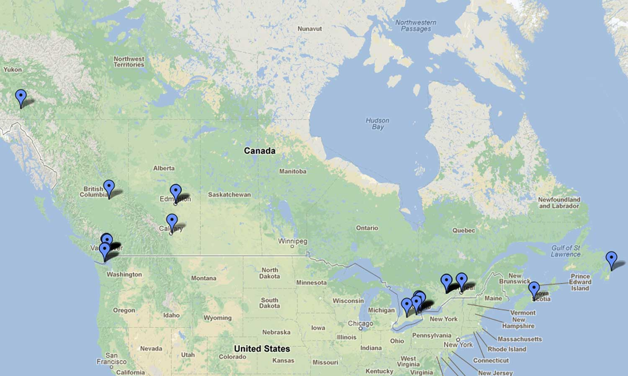
NATIONAL HIV AND HOUSING COLLABORATIVE
A national collaborative of people living with HIV, housing and support organizations, researchers, service providers, policy makers and other stakeholders.
OUR VISION
Home is where the health is. Canada is a place where all people living with HIV/AIDS have safe, supportive, secure, and affordable housing; un endroit qu’on appelle chez-soi.
OUR MISSION
Improve the health and well-being of people living with HIV by increasing access to housing
Work for policy change at the national, provincial, regional and local levels, and for innovative supportive housing programs
Demonstrate that housing is health and housing is effective health care – that home is where the health is

Slide 3
IS HOUSING THE BEST MEDICINE?
USING HIV AS AN EXAMPLE:
What is the impact of unstable housing on health?
What are the health benefits associated with supportive housing?
IF HOUSING PROVIDERS BECOME HEALTH SERVICES PROVIDERS:
What are the increasingly complex health needs of housing residents aging with chronic illnesses such as HIV?
What challenges will housing providers face and how can they respond?

Slide 4
WHAT THE RESEARCH TELLS US

Slide 5
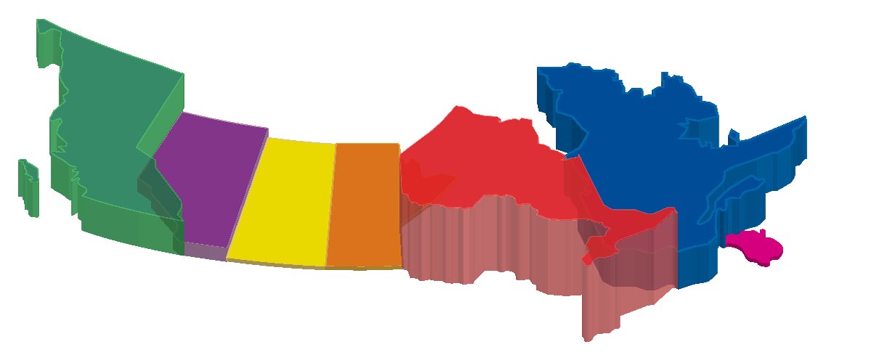
WHERE IS THE HIV EPIDEMIC IN CANADA?
CANADIAN TOTAL (2011 )
71,300
British
Columbia
Alberta
Atlantic
Canada
Saskatchewan
Manitoba
Ontario
Québec
DIFFERENT EPIDEMICS, POPULATIONS & STRATEGIES:
Gay Men and MSM (41%) Aboriginal Peoples (25%)
People Who Use Drugs (21%) African, Caribbean and Black Communities (10%)
http://www.phac-aspc.gc.ca/index-eng.php (1985-2009)

Slide 6
WHERE THE DATA COMES FROM
A FIVE-YEAR COMMUNITY-DRIVEN STUDY FOLLOWING 600 PEOPLE WITH HIV ACROSS ONTARIO
The first of its kind in Canada…
Study links between housing and health in HIV/AIDS
Identify range of housing and supportive housing options available to people with HIV in Ontario
Identify the characteristics of appropriate housing and supportive environments for people living with HIV
Determine the kind of housing options that will ensure access to health care, treatment and social services
Collaborations with the National HIV and Housing Coalition and other partners in the USA have led to a wealth of data on housing and HIV

Slide 7
HOUSING IS A SIGNIFICANT UNMET NEED OF PEOPLE WITH HIV
Ontario
USA
Nearly 50% of PSHP participants had difficulty meeting housing costs
50% living with HIV report housing instability following diagnosis
One third of PSHP participants were at risk of losing their housing
Homelessness, unemployment, and low educational level are independently associated with HIV infection

Slide 8
PEOPLE WITH HIV WHO DO NOT HAVE APPROPRIATE HOUSING EXPERIENCE WORSE PHYSICAL AND MENTAL HEALTH
WORSE PHYSICAL HEALTH
Higher mortality rates
More risky behaviors
Substance use issues
Have lower CD4 counts
Have higher viral loads
Increased likelihood to be hospitalized and use emergency rooms
WORSE MENTAL HEALTH
Higher prevalence of depression
Higher stress levels
No sense of belonging in their neighbourhoods
Sometimes I just wonder if it’s easier not to bother. Just let life and nature take its course because you don’t have to worry about it when you’re dead…

Slide 9
PEOPLE WHO ARE UNSTABLY HOUSED EXPERIENCE INADEQUATE HIV HEALTH CARE, POOR HEALTH OUTCOMES, AND EARLY DEATH
The death rate due to HIV/AIDS is 7-9x higher among homeless people than in the general population
Rates of HIV infection are as much as 16x higher among homeless people than in the general population
I don’t care and I can’t afford to. It’s just easier to say piss on the health and worry about everything else…
7-9
16X

Slide 10
LIVING WITH HIV? UNSTABLE HOUSING IS BAD FOR YOUR HEALTH
Housing instability (number of times moved since baseline) and harmful drug use over time
*Difference is statistically significant (p<0.05)

Slide 11
HOUSING IS…
HEALTH

Slide 12
THE HEALTH BENEFITS OF HOUSING
✔
Supportive housing associated with an 80% reduction in mortality
BETTER HEALTH
Reduced mortality
Viral suppression
Reduced co-infections
Reduced risk behaviours
BETTER HEALTH CARE
Effective HIV/AIDS Health Care (ART) adherence
Less likely to access costly emergency medical access
More likely to access ongoing medical services and treatment regimens, reducing risk of transmission and increasing overall health
Each new HIV infection prevented through increased housing stability saves over $300,000 in lifetime medical costs…

Slide 13
HOUSING IS…
PREVENTION

Slide 14
PEOPLE AT RISK OF HIV MORE LIKELY TO BECOME INFECTED IF THEY LACK STABLE HOUSING
PEOPLE WHO HAVE RECENTLY EXPERIENCED HOMELESSNESS ARE:
2x more likely to have a new HIV infection
3x more likely to engage in sex exchange
2x more likely to use drugs
3x more likely to inject drugs
2x more likely to have unprotected sex with a partner whose HIV status is unknown
People with HIV who lack stable housing are less likely to receive regular care, receive optimal antiretroviral therapy or adhere to therapy. They are more likely to delay entering care.
With no transitional housing to go to, my addictions are being triggered by street life…
-

Slide 15
HOUSING IS…
GOOD HEALTH
CARE

Slide 16
LIVING WITH HIV? HOUSING IMPROVES HEALTH CARE
Housing instability (number of times moved since baseline) and ARV therapy
*Difference is statistically significant (p<0.05)

Slide 17
BETTER HOUSING STATUS = BETTER ACCESS TO AND USE OF HEALTH CARE
✔
PEOPLE WITH HIV WHO ARE STABLY HOUSED ARE MORE LIKELY TO:
Access HIV primary care and adhere to medications
Utilize health and social services
Stay in continuous care
Receive care that meets clinical practice standards
HOMELESS PERSONS WITH HIV WHO RECEIVED A HOUSING PLACEMENT WERE:
2x more likely to achieve an undetectable viral load as those who remained homeless
4x more likely to enter into medical care as those who do not receive assistance
5x more likely to report a recent HIV outpatient visit than people whose housing status did not improve
6x more likely to be receiving HAART as those who remain homeless or unstably housed
If it’s not the hydro and it’s not the housing where you’re living in, it’s going to be a medication and if it’s not the medication it’s going to be about the food and if it’s not about the food it’s always about something. it’s something different everyday so you have to learn to choose and pick your battle…
+

Slide 18
WHAT OUR CLIENTS TELLS US

Slide 19
HOUSING IS HEALTH CARE
My mental health changed and also my physical health changed, yes I started to look better physically and mentally I start to think clear, I have my own space, I have my own time. I became more focused and I started to look for other problems like how to deal with my HIV rather than housing. I felt more safe towards housing, nobody knock on my door or somebody will bash me or ask me for money or something like that so feeling secure and have my own kitchen and my own space I start to feel much more stronger and more mentally stable and then I focus on other issues - education and work instead of thinking of my depression, my death I start to think of the future.
“

Slide 20
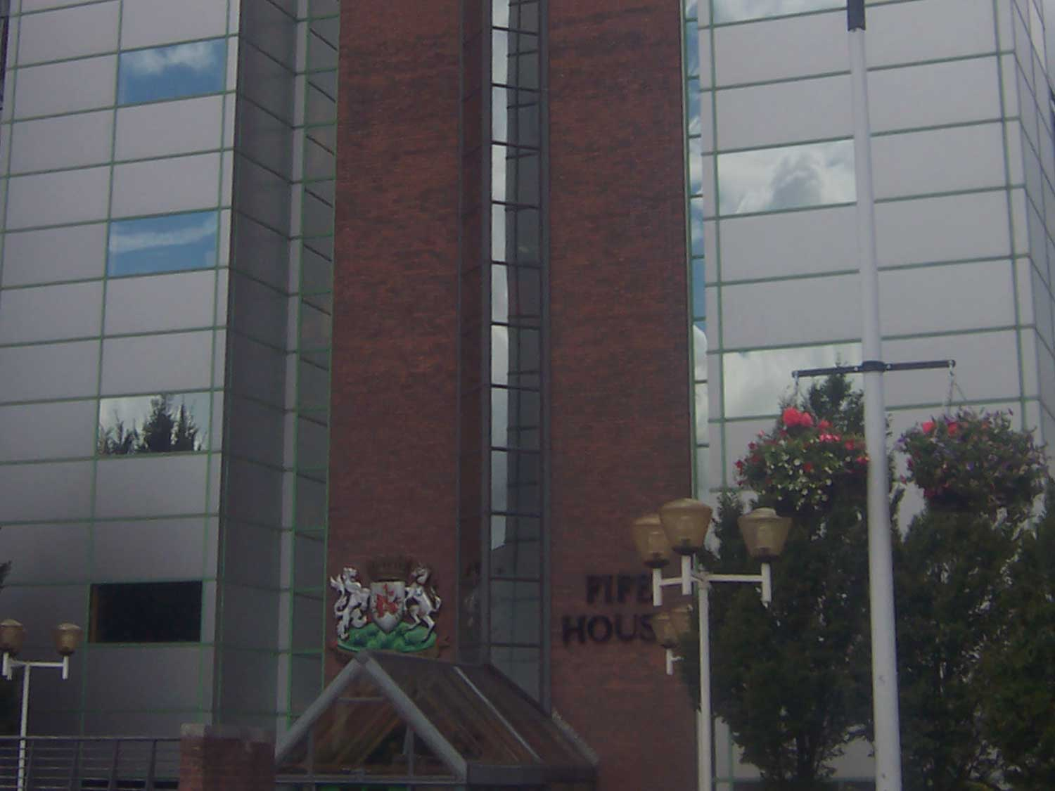
WHAT OUR PRACTICE EXPERIENCE TELLS US

Slide 21
FIFE HOUSE
About
An innovative, client-focused provider of secure and supportive affordable housing and services to people living with HIV/AIDS in the Greater Toronto Area
Mission To provide secure and affordable supportive housing and support services for persons living with HIV/AIDS
Served 600 residents & clients in 2012/2013
Provided support services to more than 200 residents/clients through our Supportive & Transitional Housing Programs and to an additional 390 clients, including 45 families, through our Homeless Outreach Program

Slide 22
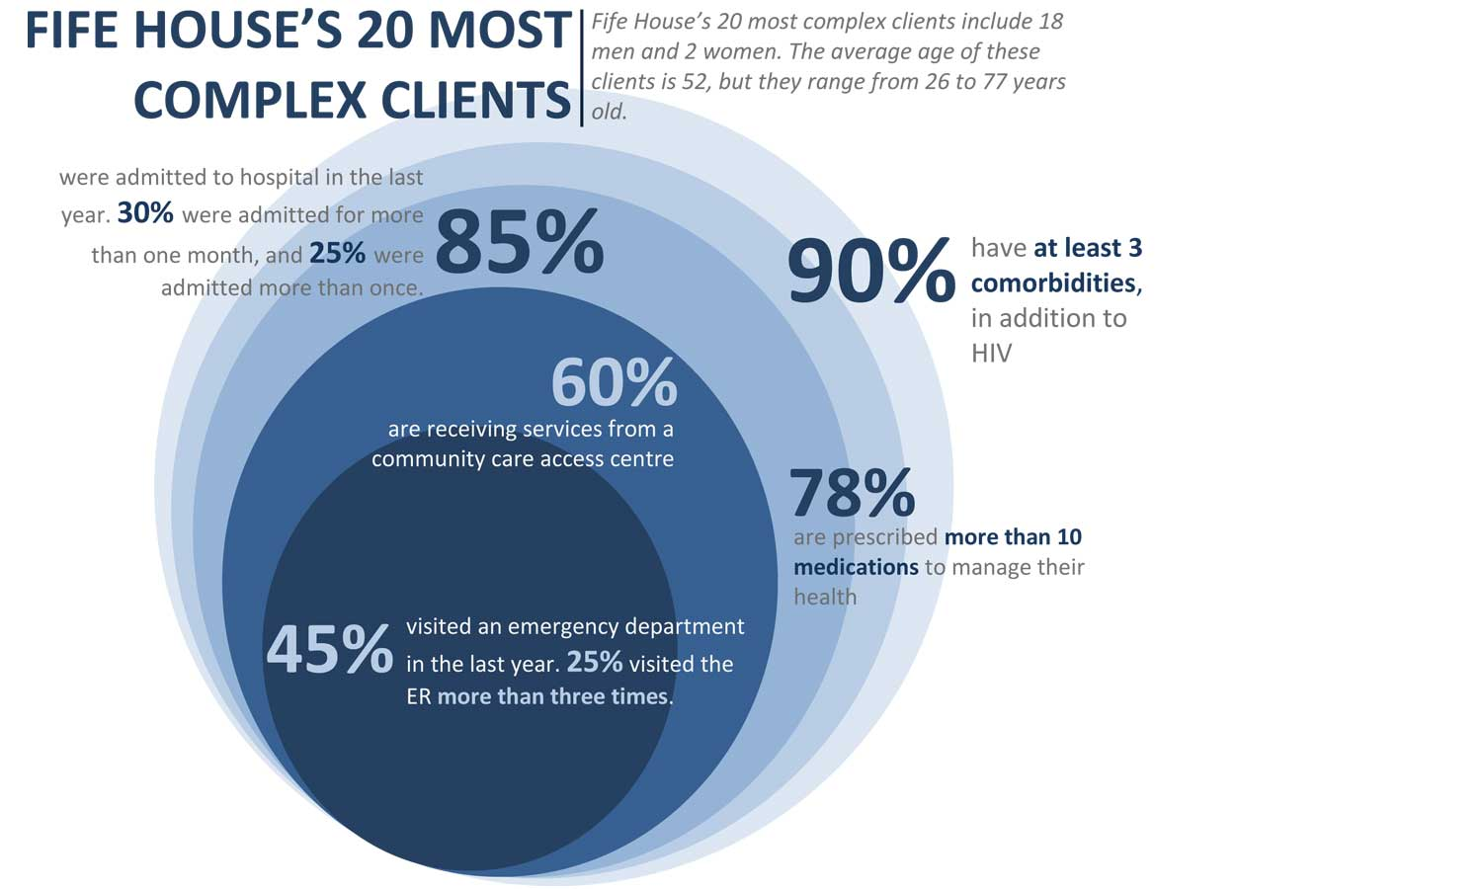
FIFE HOUSE

Slide 23
FIFE HOUSE: COMPLEX CARE FOR PEOPLE LIVING WITH HIV
Fife House and McEwan Housing and Support Services
increasing demand and longer wait lists for high support housing
McEwan Housing and Support Services
300% increase in respite stays over the last two years (mainly related to aging, accelerated aging, complex care and cognitive issues)
Casey House
more than 50% of clients are over 50
30% have HIV-related dementia
wait lists for respite care and general admissions

Slide 24
FIFE HOUSE: COMPLEX CARE FOR PEOPLE LIVING WITH HIV
Ministry of Health and Long-Term Care: Supportive Housing for People with Problematic Substance Use Program
Provides funding and rent supplements to develop harm reduction supportive housing that provides flexible, client-centred supports, which are funded separately through the Local Health Integration Network
Goal: to improve the health and social outcomes of those who frequently use addiction treatment and emergency services by providing stable housing and appropriate supports.
Fife House and Mc Ewan Housing and Support Services ASH program: meets needs of 32 individuals living with HIV/AIDS who have histories of homelessness, problematic substance use issues, and a history of inpatient hospitalizations

Slide 25
FIFE HOUSE – HIV/AIDS COMPLEX CARE PILOT PROJECT
Developing a Continuum of Enhanced Care in the Community. This is a multi-agency Pilot Project to increase cross-sector collaboration and partnerships to: address gaps in the service, care, and support needs of aging PHAs, and develop coordinated models of care that improve health outcomes.
Toronto People With AIDS Foundation Casey House
St Elizabeth Toronto Community Housing
COTA Mental Health Toronto Central Community Care Access Centre
Sherbourne Community Health St. Michael’s Hospital
The Positive Care The Medical Psychiatry Program
410 Sherbourne St Michael’s Family Health Team
McEwan Housing and Support Services/Loft Community Services

Slide 26
THE SHARP FOUNDATION (Society Housing AIDS/HIV Restricted Persons)
About
Calgary based non-profit charitable organization with a mandate to provide a ‘holistic' (medical, physical, psychosocial, and spiritual aspects) continuum of care to people living with HIV or AIDS
Mission
Our philosophy is to maintain or enhance quality of life by providing non-judgmental care and support with compassion. Each person living with HIV/AIDS will have the supports to meet their needs.
Provide a continuum of care including housing, healthcare, and support to those individuals infected or affected by HIV/AIDS
Develop services and programs for individuals requiring palliative, long term, intermediate, and independent living support
A case management team works together to address our client’s needs

Slide 27
THE SHARP FOUNDATION

Slide 28
THE SHARP FOUNDATION
CLIENT PROFILE
First Nations (up to 30%)
Over 50 years of age (40 – 50%)
Substance Abuse (60 – 75%)
HIV-related Neurological Disorders (up to 50%)
Mental Health (80 – 100%)
Sight Impairment (10%)
Below the Statistics Canada poverty line (income of less than $13,000 per year) (100%)
COMMUNITY PARTNERS
Alberta Provincial (HIV) Policy & Funding Consortium
Alberta Health Services (Harm Reduction, Southern Alberta
Clinic, Transition Services, Addictions/Mental Health, Palliative Care)
AIDS Calgary Awareness Association
Alpha House
Bow Valley College (Health Care Aides)
Calgary Drop-In and Rehabilitation Centre
Calgary Homeless Foundation
Mount Royal University (Social Work, Public Relations, Nursing)
University of Calgary (Social Work, Nursing)

Slide 29
THE SHARP FOUNDATION
Client Care and Support
Program | Beswick | Scott | Project 2011 | Proj. Kath | Ind. House | Other Sites
24/7 Staffing | X | X |  | X
Medication Administration | X | X |  | X
Direct Observed Therapy | X | X | X | X
Appointment Management | X | X | X | X
Case Management | X | X | X | X | X | X
Resident Mentor |  | X | X |  | X
Nutrition Management | X | X | X | X | X | X
Family Support | X | X | X | X | X | X
Subsidized Rent | X | X | X | X | X
Money Management | X | X | X | X | X | X
Active Living Program | X | X | X | X | X | X
Medical Management - Nurse | X | X | X | X | X | X

Slide 30
THE SHARP FOUNDATION
Social Return on Investment
With SHARP | Without SHARP
Care, support and a home for up to 18 highly-marginalized clients Clients are supported through medical, social and emotional challenges Continuum of supports for short-term and long-term Cost = $100 or less per client, per day at SHARP | Highly-marginalized, at-risk individuals live on the street Little or no support, resulting in regular interactions with police & Emergency Medical Services (average annual cost of a homeless person = $100,000) Average emergency admissions per year: 10 Cost = $1,600 per client, per day in hospital

Slide 31
PEOPLE LIVING WITH HIV HAVE COMPLEX NEEDS

Slide 32
APPROACHING CLIENTS WITH COMPLEX CARE ISSUES – ONTARIO
CASE STUDY 1: JANE
52-year old woman
Released from a ten-year sentence in a correctional facility one year ago
Living in a new city (few connections or supports)
Acquired HIV during her first year in the correctional facility
Suffers from schizophrenia, neuropathy and emphysema
Injects heroin, drinks alcohol (heavily)
Prescribed 12 different medications to manage health conditions
Transgender, self-identifies as a lesbian
In a relationship with a 45-year old transgender woman who also injects heroin
Receives supportive housing based on a housing first model

Slide 33
APPROACHING CLIENTS WITH COMPLEX CARE ISSUES – ONTARIO
CASE STUDY 1: JANE - THE OUTCOME
Staff skills and training
Physical space needs
Types of services provided by the housing service organization
Services accessed from other community organizations
Partnerships developed with other organizations in the community

Slide 34
APPROACHING CLIENTS WITH COMPLEX CARE ISSUES – ALBERTA
CASE STUDY 2: HOPE
25-year old woman
HIV+ since age 18, also suffers from hepatitis C, fetal alcohol spectrum disorder, and schizophrenia
Severe vision impairment and a colostomy resulting from alcohol poisoning at age 23
Homeless and involved in sex work since age 13, when she moved from the reserve to the city
History of violence and behavioural issues
Substance use includes alcohol, crack, and aerosols
Gives half of her social assistance funds to a pimp who she continues to work with
Has been banned from several support facilities

Slide 35
APPROACHING CLIENTS WITH COMPLEX CARE ISSUES – ALBERTA
CASE STUDY 2: HOPE
Arrested and charged with assaulting a hospital security guard
Housing support organization worked with the pimp to provide bail and bring her back to the residence
Housing support organization facilitated the court process
In court, Hope’s HIV status was disclosed to extended family members for the first time

Slide 36
APPROACHING CLIENTS WITH COMPLEX CARE ISSUES – ALBERTA
CASE STUDY 2: HOPE - THE OUTCOME
Changes to organizational policies and procedures to better accommodate clients with extremely complex issues
Housing support organization catalyzed reengagement with extended family
Client became a partner in promoting her own health and wellness

Slide 37
WHERE DO PEOPLE WITH HIV FIT IN THE LARGER HOUSING PICTURE?
WHERE IS SUPPORTIVE HOUSING FOR PEOPLE WITH HIV LIKELY TO HAPPEN?
There are only a handful of communities across Canada that have the critical mass of people with HIV to support HIV-dedicated supportive housing services (e.g. Vancouver, Calgary, Toronto, Ottawa, Montreal, St. John’s)
WHAT HAPPENS ELSEWHERE?
People with HIV will be “mainstreamed” with others who need affordable and/or supportive housing
When that happens… What are the challenges for housing providers? What do you need to know? What do you do differently? What is the same?

Slide 38
SMALL GROUP DISCUSSION
Are housing providers becoming health care providers?
What are the implications for our organizations, programs and staff?
What strategies are housing providers using to manage these challenges?

Slide 39
Conclusion: Housing is The BEST Medicine
PREVENTION
HEALTH
HOUSING IS…
GOOD HEALTH
CARE
GOOD POLICY

Slide 40
Conclusion: Housing is The BEST Medicine
The growing role that housing services will play in health care will create ongoing challenges and opportunities for housing providers
The National HIV and Housing Collaborative may be able to help

Slide 41
www.healthyhousing.ca
Snapshot of housing and HIV in each province
Listing of housing and HIV/AIDS service organizations (local, provincial, national, and international)
Comprehensive database of housing, HIV, and homelessness that includes grey literature
Listing of researchers and research projects which include a component related to HIV, housing, and homelessness
Listing of conference and events related to housing and homelessness
Forum for housing workers, HIV/AIDS workers, researchers, advocates and PHAs to come together, share experiences and discusses strategies for improvement
TEMPORARY ADDRESS DURING SITE DEVELOPMENT AND MIGRATION:
housing.ohtn.on.ca

Slide 42
NATIONAL HIV AND HOUSING COLLABORATIVE Who We Are…
RESEARCH, POLICY, EDUCATION
Canadian Aboriginal AIDS Network, Ottawa
Canadian AIDS Society, Ottawa
Canadian Association of HIV Research, Ottawa
Canadian Housing & Renewal Association, Ottawa
Columbia University, New York
CIHR Centre for REACH, Toronto
COCQ-SIDA, Montreal
McMaster University, Hamilton
National Aboriginal Housing Association, Ottawa
Ontario HIV Treatment Network, Toronto
Pacific AIDS Network, Vancouver
San Francisco Department of Public Health, San Francisco
SHARP Foundation, Calgary
University of Victoria, Victoria
York University, Toronto
SERVICE PROVIDERS
AIDS Committee of Newfoundland & Labrador, Newfoundland
AIDS Thunder Bay, Thunder Bay
AIDS Vancouver Island, Vancouver
ASK Wellness (AIDS Society of Kamloops), Kamloops
Alberta Health Services, Edmonton
Bruce House, Ottawa
Blood Ties Four Directions, Whitehorse
Catholic Social Services, Edmonton
Dr. Peter Centre, Vancouver
Fife House, Toronto
John Gordon Home, London
LOFT Community Services, Toronto
Maison D'Herelle, Montreal
McLaren Housing Society, Vancouver
Positive Living BC, Vancouver
Positive Women’s Network, Vancouver

Slide 43
CITATIONS
Aidala, et al. (2005, 2007)
Bacon, et al. (2010)
Buchanan, et al. (2009)
Culhane (2001)
Denning & Dinenno (2010)
Kerker (2005)
Kidder et al. (2007, 2008)
Leaver, et al. (2007)
Marshall (2009, 2011)
Roberson (2004)
Schackman (2006)
Schwartz et al. (2009)
Walley et al. (2008)
Wilson, et al. (2011)
Wolitski, et al. (2007)

Slide 44
Thank You. Let’s make healthy housing a reality for all.
Keith Hambly Floyd Visser
FIFE House The SHARP Foundation
Executive Director Executive Director
490 Sherbourne Street, 2nd Floor Box 172, 2, 3012 – 17 Avenue SE
Toronto, Ontario, M4X 1K9 Calgary, Alberta, T2A 0P9
KHambly@fifehouse.org f.visser@thesharpfoundation.com

