Slide 1
Rooftops Canada – Abri International
The international development program of the Canadian social and cooperative housing sector.
Working in Sub-Saharan Africa on housing development and finance, responses to HIV and AIDS, and urban food security.
Notes:
Our work concentrated in Sub-Saharan Africa: S.A., Kenya, Tanzania, Zimbabwe, Cameroon.

Slide 2
The Challenge
1.2 Billion people – 1/3 of the global urban population - live in slums.
This includes 70% of urban Africans, 225 million people
Notes:
Soweto

Slide 3
Our Response
Rooftops Canada partners with housing groups, housing co-ops & credit unions, NGOs, the private sector, financial institutions, trade unions, governments and international agencies to improve housing conditions and build sustainable communities
Notes:
Came out of the co-op sector 20 years ago. Expanded to the non-profit. Major housing partners: CHF, CHRA, ONPHA, BCNPHF, NBNPHA CQCH

Slide 4
Rooftops Study Tour, July 2012
Johannesburg, South Africa
Nairobi, Kenya
5 Canadian participants from CHRA, ONPHA, BCNPHA, CHF Canada, CQCH
2 weeks, lots learned.
Notes:
Good Neighbour co-op, Nairobi

Slide 5
Our work in Africa
Technical Assistance and Operational Support
Advisors on all aspects of housing development & management, financing, capacity building and governance.
Young professional interns
Housing and HIV/AIDS, urban food security
Exchanges w/Canada
Loans/guarantees to partners

Slide 6
Jo’burg is a big city !
The informal economy rules
Soweto – shelters and new housing
Notes:
View from AA building – informal economy - Soweto, the shelters and new housing.

Slide 7
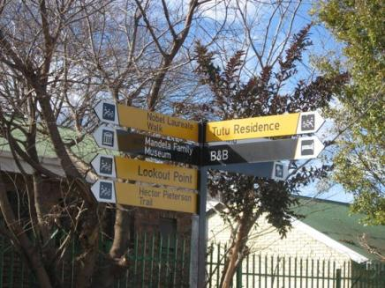
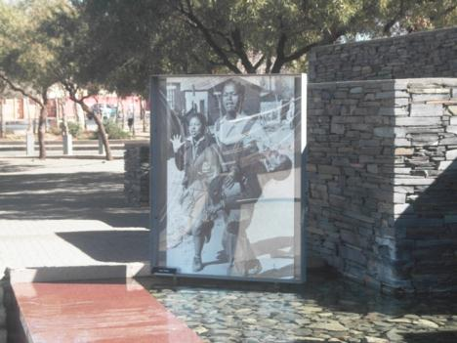
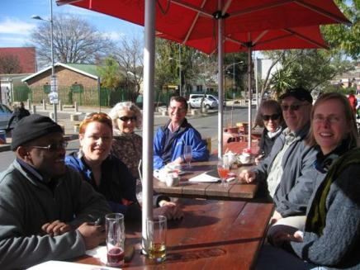
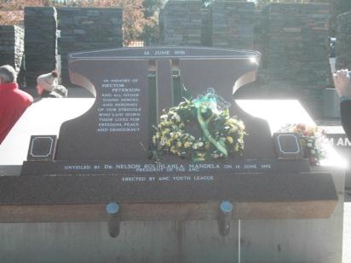
Notes:
Soweto – Near homes of Mandela and Tutu, Hector Peterson Museum

Slide 8
Johannesburg , South Africa
Our partners
The context
NASHO – National Assoc. Social Housing Organisations (18 members, 22,000 units, 15 yrs experience)
SHRA – Social Housing Regulatory Agency
Social housing in SA is non-profit rental
Post apartheid still very present
Federal and Provincial capital subsidies (40-50%)
No operating subsidies
Informal economy, no safety net for many people

Slide 9
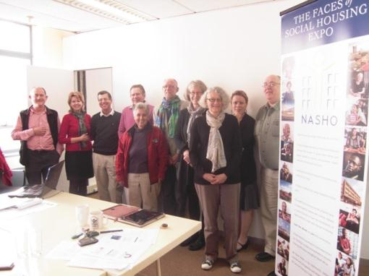
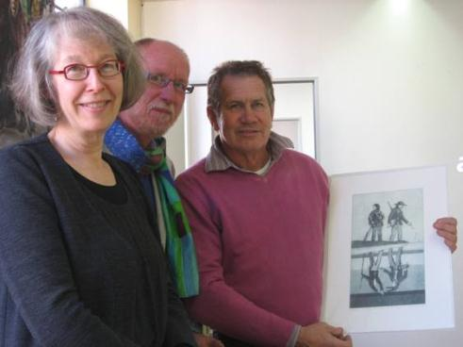
National Association of Social Housing Organizations - NASHO

Slide 10
Johannesburg
JHC – Johannesburg Housing Company - PNP
JOSHCO – Municipal Housing Corp
Notes:
15 years old, over 4000 units, started acquisition, now building new. Long time exchange with TCHC

Slide 11
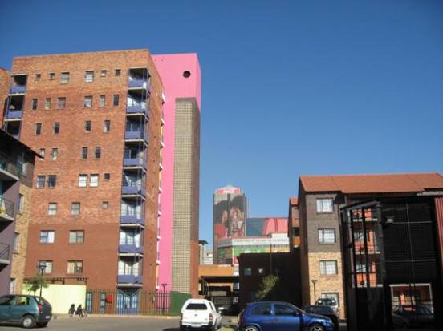
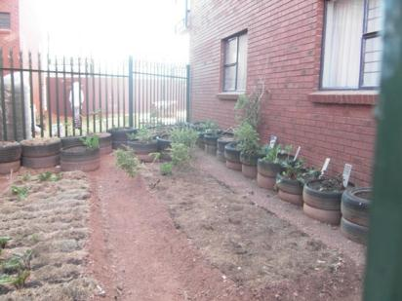
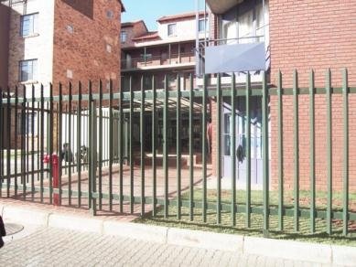
JHC – Brickfield Project – Urban design drew heavily from the St. Lawrence Neighbourhood redevelopment in Toronto

Slide 12
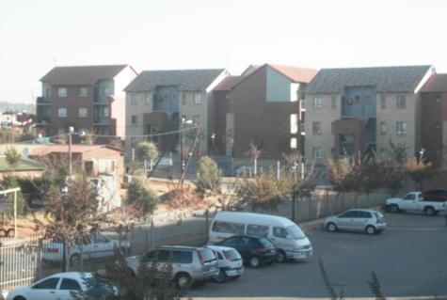
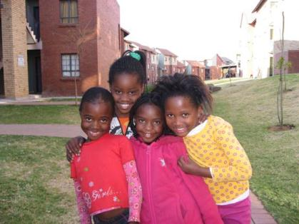
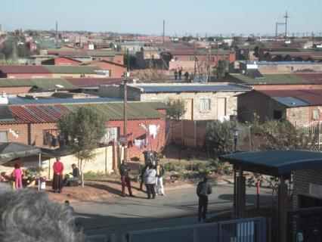
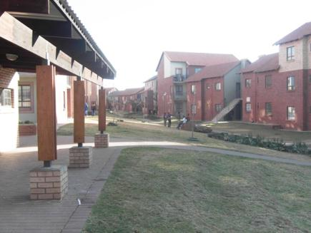
JHC – Project in Cosmo City

Slide 13
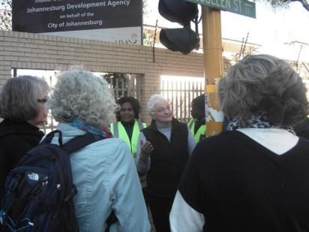
Johannesburg - Reclaiming downtown
Hillbrow
eKhaya Neighbourhood

Slide 14
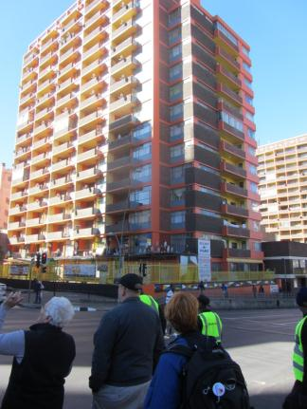
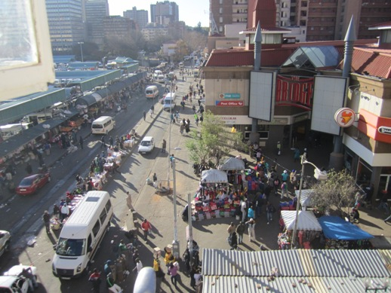
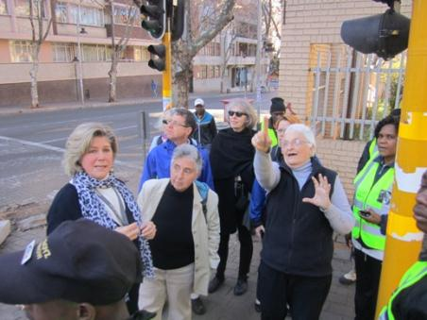
Josie Adler – the force behind the eKhaya neighbourhood renewal initiative

Slide 15
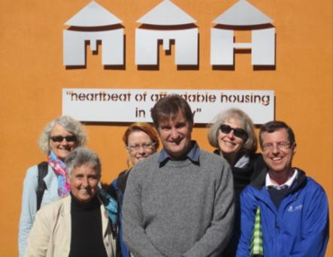
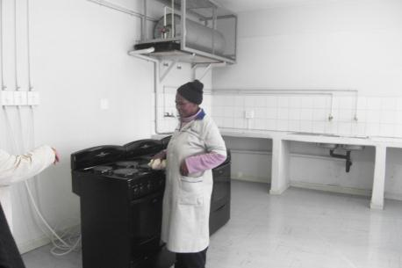
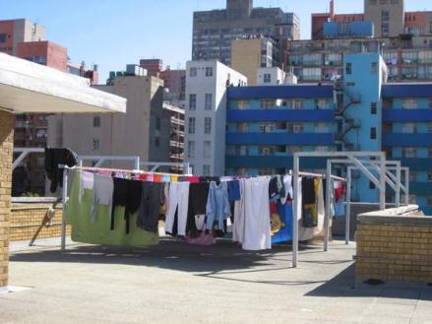
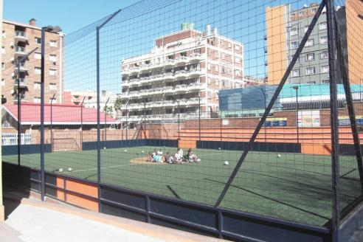
Madulammoho Housing Association – NASHO member and eKhaya partner

Slide 16
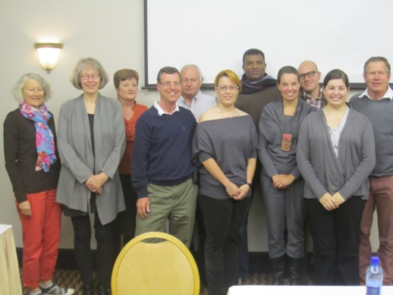
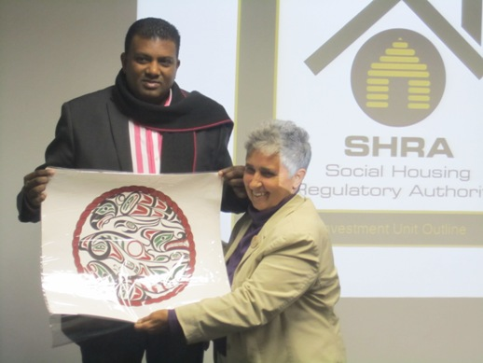
Social Housing Regulatory Agency - SHRA

Slide 17
Nairobi – The context
3.5 Million residents, no jobs
The co-op model starts with savings groups
No government housing programs
Income is mostly through self employment.
Interest rates in 2011 from 8% to 23%
Corruption, instability and related ethnic violence

Slide 18
Nairobi, Kenya
NACHU – National Co-op Housing Union of Kenya
Good Neighbour Co-op
Provide capacity and development expertise to housing co-ops
Savings and housing microfinance loans
Training on governance, gender equality, AIDS responses, advocacy

Slide 19
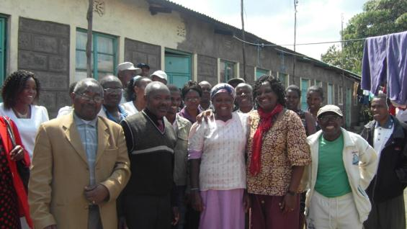
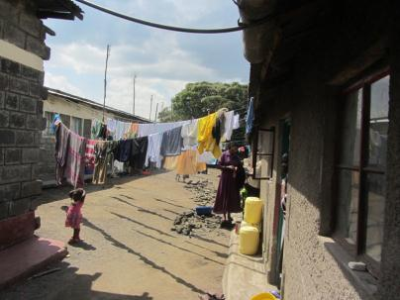
Nakuru

Slide 20
Nakuru
One woman’s story
Landlady and Grocer

Slide 21
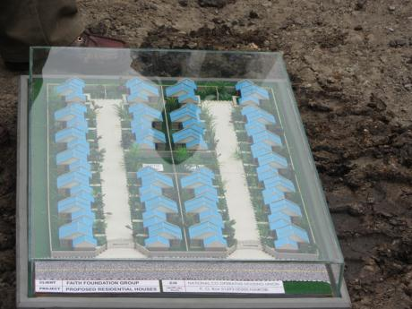
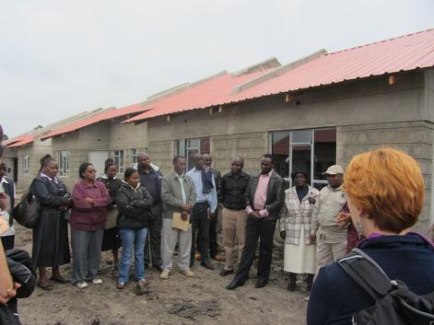
Nairobi – Faith Foundation Co-op

Slide 22
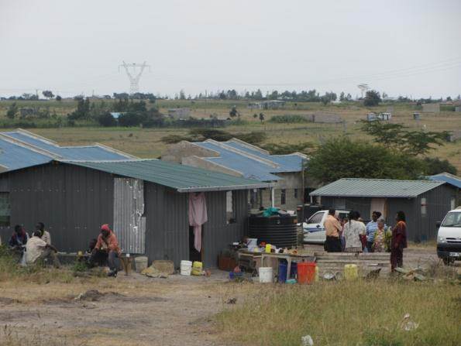
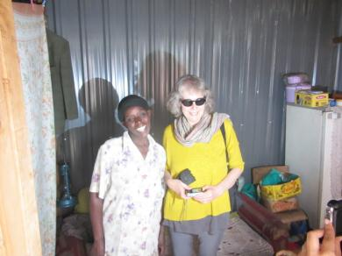
Nairobi – Nguma Mbega Housing Co-op

Slide 23
Nairobi – Urban Food Security
Creating food and income
Intensive use of space
Notes:
Partnering with the Lamba Institute.

Slide 24
Farmers in the City
Greenhouses, fish ponds
Goats, chickens, rabbits

Slide 25
Very different, not so different
Johannesburg, S.A.
Nairobi, Kenya
A robust social housing sector – 15 years now
Rental is the norm
Government program for capital
Informal economy
Slum clearance issues
Urban agriculture
A successful national association- NACHU
Ownership co-ops are the norm
No government $$
Informal economy
Slum clearance issues
Urban agriculture

Slide 26
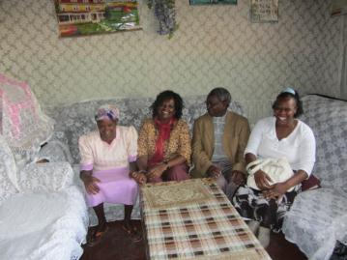
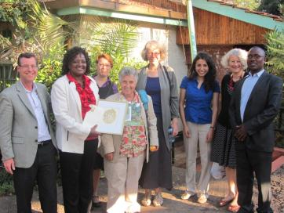
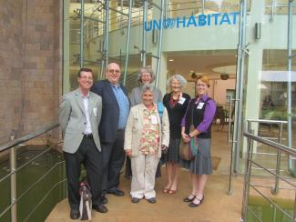
How can I/We help?
Hosting visitors, participating in exchanges and study visit as partner rep
Contributing to housing microfinance fund
Promoting Rooftops Canada in your networks
Fundraising activities
Advocacy campaigns
Providing technical assistance

Slide 27
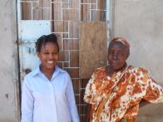
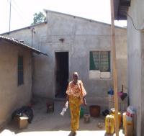
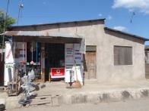
Building Homes, Building Lives
Client: Zainabu Mbaruku Msunga Age 68 years Marital Status: Widowed Dependents: 7
Job: Juice and Soap Sales
Loans: 3 loans of $336, 1 for $424 Transformed a mud hut into house and shop.
Tanzania, $60K for our partner, WAT Human Settlement Trust.
CIDA matching adds $180K
To purchase land and provide micro-loans.
Capacity building, training and technical assistance.

Slide 28
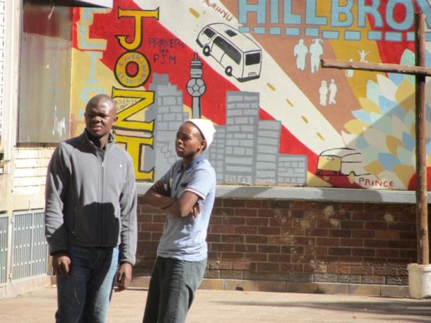
Rooftops Canada - Abri International
720 Spadina Ave,
Suite 313
Toronto, ON
M5S 2T9
CANADA
Tel: 416-366-1445
Fax: 416-366-3876
E-mail:
info@rooftops.ca
Website:
www.rooftops.ca

Slide 29
Oh, and there were giraffes too!
Giraffes have 7 neck vertebrae, same as humans
Giraffes walk using left/right, using both front and back legs
The male giraffe has a pronounced protrusion on his “forehead”
More safari pictures available on demand!

