Slide 1
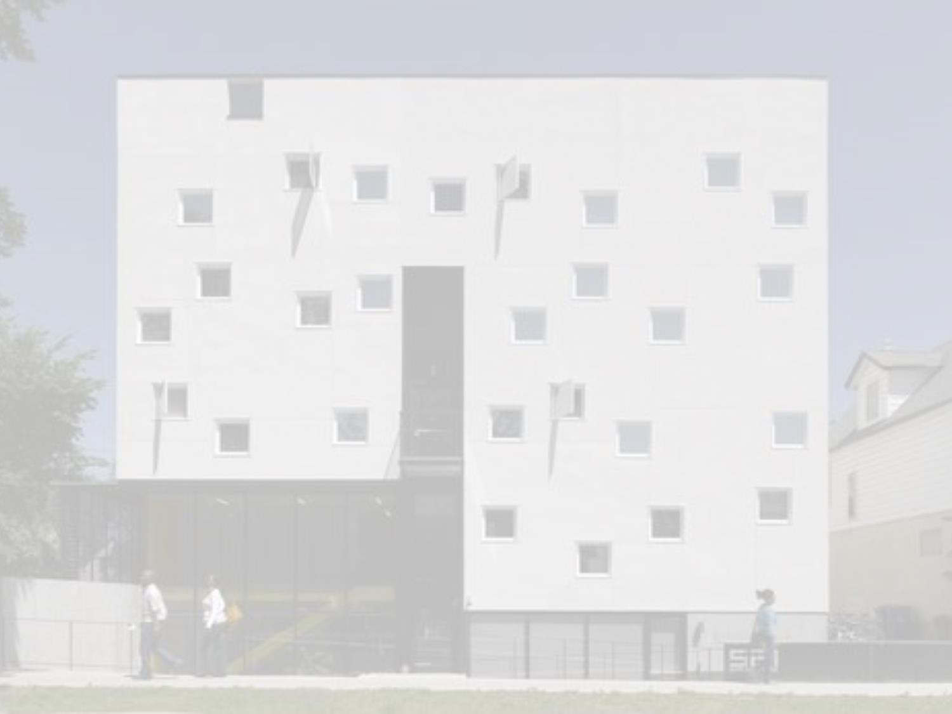
Double the crisis: Syrian refugees amid Winnipeg’s low income housing challenges
Hani Al Ubeady
Housing Counselor
Manitoba Interfaith Immigration Council
&
Dr. Ray Silvius
Assistant Professor
University of Winnipeg

Slide 2
Our Research Project
Refugee Housing Histories and Housing Trajectories: The Global-Local Nexus
3 yrs./$50,000 to study refugees, housing outcomes, and ideas of home in Winnipeg, MB
Community-based participatory research
Ethnographic
(Mini)longitudinal

Slide 3
What about the Syrians?
Welcome Place, housing arm of Manitoba Interfaith Immigration Council:
From Nov. 4, 2015 – March 11, 2016:
928 Syrian arrivals to Manitoba
766 of which were Government Assisted Refugees

Slide 4
What about the Syrians?
Re: housing: Syrian refugees as ‘low income plus’:
Fast processing times as mandated by Immigration, Refugees and Citizenship Canada (WP reports 10 days to move out of transitional housing)
Refugee resettlement needs

Slide 5
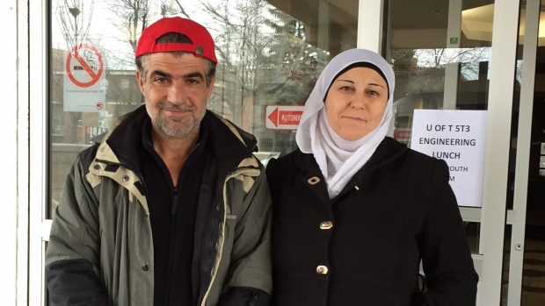
Homes, Not Hotels in Manitoba
“Syrian refugees in GTA hotels struggle to find affordable housing”
Source: http://www.cbc.ca/news/canada/toronto/programs/metromorning/refugees-hotel-housing-1.3485542

Slide 6
Homes, Not Hotels in Manitoba– How?
‘Political will’ at provincial/federal levels
Increase in human resource capability
Increase in temporary housing
Increase in long-term housing
Rent Supplement Program

Slide 7
Staffing
WP staff increases from approximately 40 to 79 (January – April 2016)
Housing team assembled – 3 experienced housing counsellors, 6 new hires – under new Manager of Permanent Refugee Resettlement
Three teams of three
Positions temporary, funded (mostly) by IRCC, high-skilled

Slide 8
Transitional Housing
2 New Buildings for Temporary/Transitional Housing
‘Building A’
6 Floors, 30 Units dedicated to Syrian refugees
Funding from Province
Rent supplemented
‘Community Atmosphere’

Slide 9
Transitional Housing
2 New Buildings for Temporary/Transitional Housing
‘Building B’
Leased to WP, by Province, for $1
3 month lease, possibly renewable
No longer used for Syrian GARs

Slide 10
Long Term Housing
Canadian Context
1980s: Feds fund 10 percent of new/social incoming housing construction in Canada
2nd lowest amount of social housing (as percentage of overall housing stock) of any advanced industrial nation @ 5 percent (Silver, 2011, p.33)

Slide 11
Long Term Housing
Winnipeg/Manitoba Context
Winnipeg: Chronically short of affordable housing stock in 20th c. (Silver, 2015)
Since early 2000s, Winnipeg’s vacancy rate between 1-2% (Brandon, 2015, p. 34)
2011: >%50 of Winnipeg rental households with at least one of CMHC’s ‘core housing need:’
costing more than 30 percent of income;
unsuitable # of rooms (family size);
in need of major repairs (Brandon, 2015, pp.29-30)

Slide 12
The Manitoban/ Canadian Context: Mind the Growing GAP?
For GARS, a growing GAP:
Between shelter allowance provided under Resettlement Assistance Program
AND cost of available housing
MB Employment and Income Assistance housing allowance (basis of federal Resettlement Assistance Rates) unchanged for 2 decades prior to 2014 (Putko, 2013)
From WP staff: from buildings with swimming pools to dilapidated inner city housing

Slide 13
MIND the Growing GAP?
Manitoba Resettlement Assistance Rates as of January, 2014
RENT & UTILITIES | MIN | MAX | RENT & UTILITIES | MIN | MAX
SINGLE SHARING | $285 | $311 | FAMILY OF FIVE | $488 | $588
SINGLE LIVING ALONE | $285 | $360 | FAMILY OF SIX | $513 | $613
COUPLE | $387 | $487 | FAMILY OF SEVEN | $537 | $637
FAMILY OF TWO | $387 | $487 | FAMILY OF EIGHT | $561 | $661
FAMILY OF THREE | $430 | $530 | FAMILY OF NINE | $585 | $685
FAMILY OF FOUR | $471 | $571 | FAMILY OF TEN | $609 | $709
Source: Silvius et al, 2015
Average cost of 3+ bedroom apartment in Wpg | $1,180 (Oct 2013) $1,191 (Oct 2014)
Source: https://www.cmhc-schl.gc.ca/odpub/esub/64479/64479_2014_A01.pdf?lang=en

Slide 14
Long Term Housing: Provincial Policy Mechanisms
Rent Supplement Program (from MB Housing and Community Development):
Pay the difference between market rate and housing budget of eligible candidates

Slide 15
Rent Supplement Program
Why does it work for Syrian refugees?
Expanded specifically for Syrian resettlement
Eligible units approved by MB govt. (safety and cleanliness), placed on inventory
Family can ‘move right in’ in short period of time with assurance that different between budget and unit is covered

Slide 16
Rent Supplement Program
Why does it work for Syrian refugees?
Expanding the range of houses
Higher quality housing
New neighbourhoods
Size of units
Large families with special needs
Program has been put on hiatus since April 2016

Slide 17
Next Steps
Anticipating prolonged global refugee crises, enhance social and subsidized housing capabilities
Restore the Rent Supplement Program for ‘second wave’ of Syrian arrivals
Expanding the Rent Supplement Program for all GARs
And PSRs?

Slide 18
Next Steps
Convey political capital and social good will demonstrated towards Syrians into permanent capabilities for the refugee serving sector
Discussion on low income realities of all refugees

Slide 19
Additional Sources
Brandon, J. (2015). The more things change: low-income housing in Winnipeg today. In J.Silver & J.Brandon, Editors, Poor Housing: A Silent Crisis. (27-46). Fernwood Press.
Putko, K. (2013). “The role of municipal, provincial and federal governments in addressing the affordable housing needs of refugees in Winnipeg.” Unpublished manuscript developed for Welcome Place, Manitoba Interfaith Immigration Council.
Silver, J. (2011). Good Places to Live: Poverty and public housing in Canada. Fernwood Pub.
Silver, J. (2015). Chronic! A brief history of low-income housing in Winnipeg. In J.Silver & J.Brandon, Editors, Poor Housing: A Silent Crisis. (8-26). Fernwood Press.
Silvius, R., Al-Ubeady, H., Halldorson, E. & Praznik, J. (2015). Refugees and housing in Winnipeg’s inner-city: turning organizational knowledge into policy options. In J.Silver & J.Brandon, Editors, Poor Housing: A Silent Crisis. (96-111). Fernwood Press.

Slide 20
Please contact us
Hani Al Ubeady
hania@miic.ca
Ray Silvius
r.silvius@uwinnipeg.ca

