Slide 1
The Missing Piece: How Housing Policy Benefits from a Socio-Economic Perspective
By Nick Falvo, PhD
CHRA Webinar
November 17, 2016

Slide 2
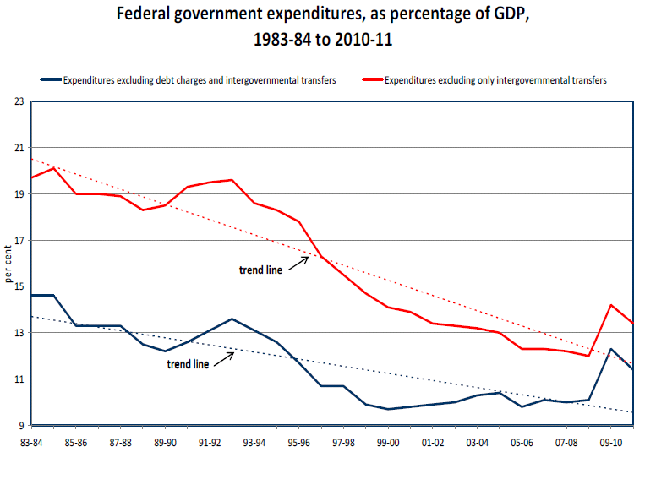
Notes:
Source: Mendelson, M. (2012). Is Canada (still) a fiscal union? Retrieved from Caledon Institute of Social Policy website: www.caledoninst.org/Publications/PDF/998ENG.pdf.
Note: The above image has been copied and pasted directly from page 2 of the report.

Slide 3
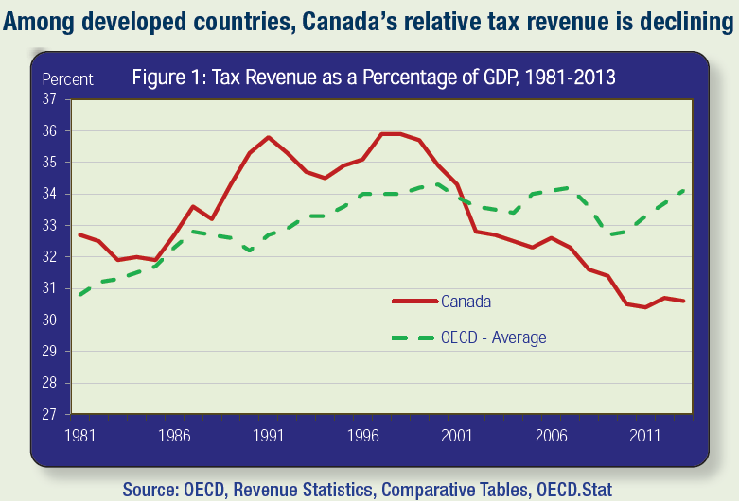
Notes:
Source: Citizens for Public Justice. (2015). Taxes for the common good: A public justice primer on taxation (Fact Sheet Series). Retrieved from Citizens for Public Justice website: http://www.cpj.ca/sites/default/files/docs/files/Taxes-for-the-Common-Good-FINAL.pdf
Note: “The data in the graph is OECD total revenue: it includes all levels of government” (M. Veall, personal communication, September 15, 2015).

Slide 4
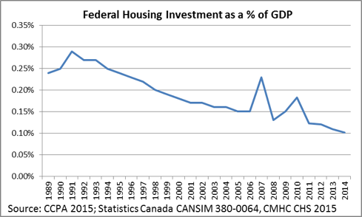
Notes:
Source: Wellesley Institute. (2015, September 22). Access to housing – HEIA in the federal election. Retrieved from http://www.wellesleyinstitute.com/housing/access-to-housing-heia-in-the-federal-election/

Slide 5
Rental Housing Production
Notes:
Source: Pomeroy, S. (2013, May). The fundamentals of housing policy & governance: A condensed, one-day course. Carleton University, Ottawa.
Note: This slide has been copied and pasted directly from Mr. Pomeroy’s slide deck. It appeared as Slide #24 in his deck.

Slide 6
Erosion by Stealth
Annual Value of NHI in 1999 (in 2015 dollars) | Current Annual Value of HPS (in 2015 dollars)
$341M | $119M
Ergo: HPS’ current annual value, adjusting for inflation, is a mere 35% of the NHI’s original value.
Notes:
Note: Doberstein (2012) asserts that, in fact, the “federal outlay” on NHI, per year, “averaged [just] $184 million.”
Source: Doberstein, C. (2012). Applying European ideas on federalism and doing it better? The government of Canada’s homelessness policy experiment. Canadian Public Policy, 38(3), 395-410. Quotes are from page 400.
Notes: “The initial phase of the NHI ran from 1999-2003 and is referred to as ‘Phase 1’. In 2003, the NHI was renewed for an additional three years ($405M), with a further one-year extension (2006-2007) announced in November 2005 ($134.8M).” Source: Human Resources and Skills Development Canada, Strategic Policy and Research Branch, Evaluation Directorate. (2008). Summative Evaluation of the National Homelessness Initiative (SP-AH-693-05-08E). Retrieved from http://publications.gc.ca/site/eng/334320/publication.html Note: Quote is from page i.

Slide 7
Unemployment Rate in Canada, annual, 1946-2011
Notes:
Source: Seccareccia, M. (2012, March). Is full employment an achievable goal? Paper presentated at Policy Choices: Austerity, Inequality, or Full Employment?, Sudbury, ON.
Supply-side reasons often given for increase in official unemployment rate since early-1980s: women entering the labour force; young people (i.e. baby boomers) becoming more choosy re: what work they’ll accept (in part due to unemployment insurance); changes in composition of jobs due to globalization.
Demand-side reasons often given for increase in unemployment rate since early-1980s: governments and private sector becoming afraid to spend; growth of service sector (i.e. casual jobs).
Source on both supply-side and demand-side reasons: M. Seccareccia, personal communication, May 31, 2013.

Slide 8
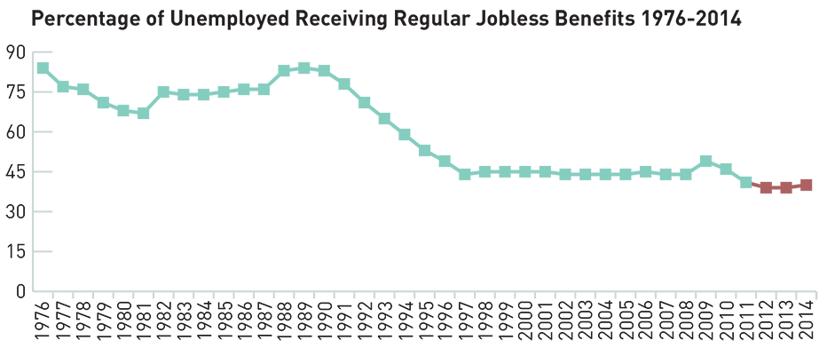
Notes:
Source: Granofsky, T., Corak, M., Johal, S., & Zon, N. (2015). Renewing Canada’s social architecture. Retrieved from http://social-architecture.ca/wp-content/uploads/FramingPaper.pdf

Slide 9
Notes:
Note: This line graph was put together by John Stapleton. It was included in an Excel file that was circulated in the 10 January 2016 edition of the Canadian Social Research Newsletter. Mr. Stapleton’s Excel file can be downloaded here: http://openpolicyontario.com/wp/wp-content/uploads/2016/01/Copy-of-Ontario-unemployment-and-SA-rates-1981-to-2008-2009-monthly-to-November-2015.xlsx
Data Sources for the official unemployment rate and population: Statistics Canada. Data Sources for social assistance caseloads: Ontario Ministry of Community and Social Services.

Slide 10
Causation
Difficult to establish
Statisticians like randomized controlled trials (RCTs).
But RCTs are often impractical, unethical and expensive
However, it’s very highly likely that the economic factors just discussed have played a major role in creating challenges pertaining to affordable housing.

Slide 11
My Advice
Don’t exaggerate what you know, and be careful of people who do.
Don’t over-predict, and be careful of people who do.
Reach out to people who understand different areas of the social welfare system.
Attend conferences where people talk about these issues.

Slide 12
More Advice
When graduate students do practicums at your organization, have them write annotated bibliographies or literature reviews on topics you’d like to learn more about.
Encourage your staff to read about social policy on a regular basis.

Slide 13
Still More Advice
Read Thomas Walkom’s column in the Toronto Star.
Subscribe to the Canadian Social Research Newsletter.
Read the blog of the Progressive Economics Forum.
Read reports and blog posts published by the Canadian Centre for Policy Alternatives, the Caledon Institute of Social Policy and the Institute for Research on Public Policy.

Slide 14
Twitter Advice
Follow these people on Twitter:
Rob Gillezeau
Seth Klein
David Macdonald
Trevor Tombe
Armine Yalnizyan

Slide 15
Thank You

